Slide 1
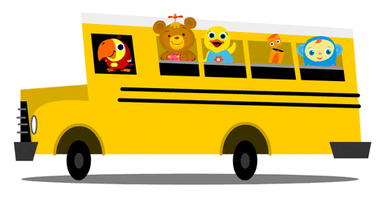
Lesson 1
Unit 4
I go to school by bus

Slide 4
Listen and point

Slide 6
Listen and repeat

Slide 8
Listen and chant

Slide 10
It’s play time!

Slide 11
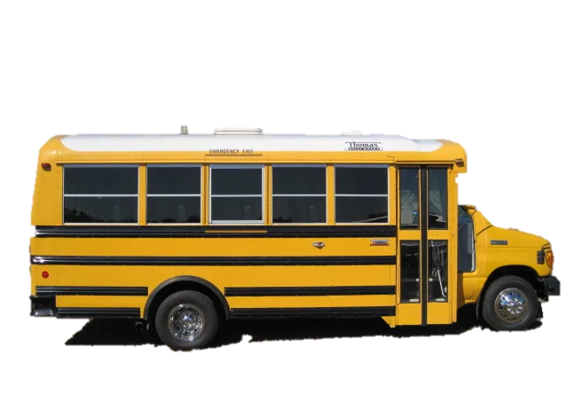
motorbike
bus
bike

Slide 12
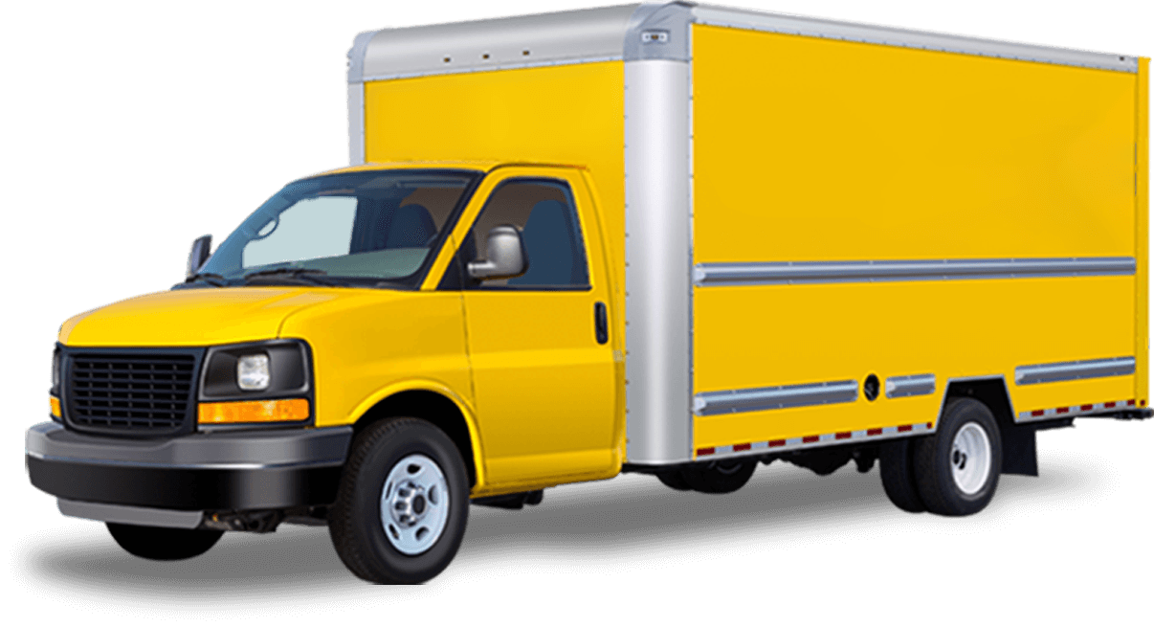
boat
car
truck

Slide 13
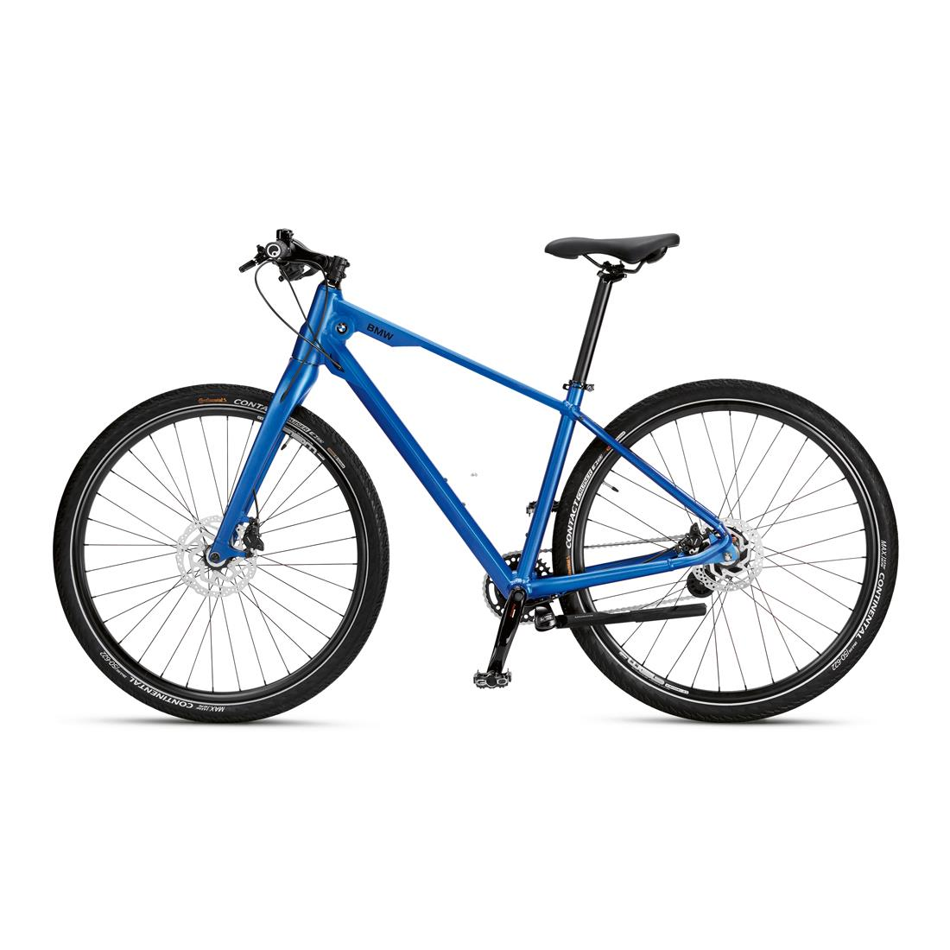
bike
truck
boat

Slide 14
boat
bus
car

Slide 15
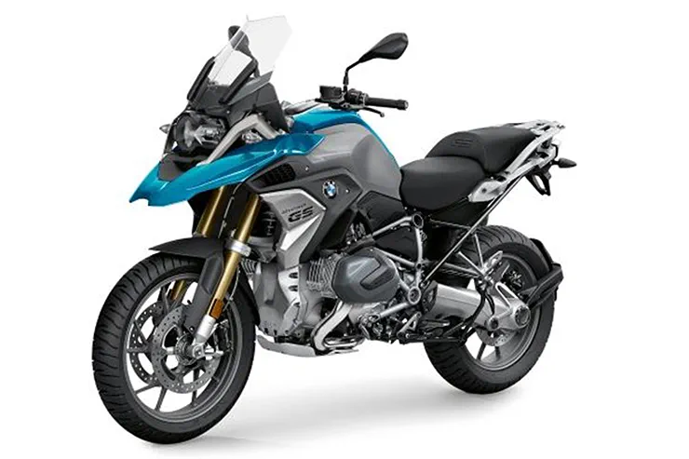
bike
truck
motorbike

Slide 16
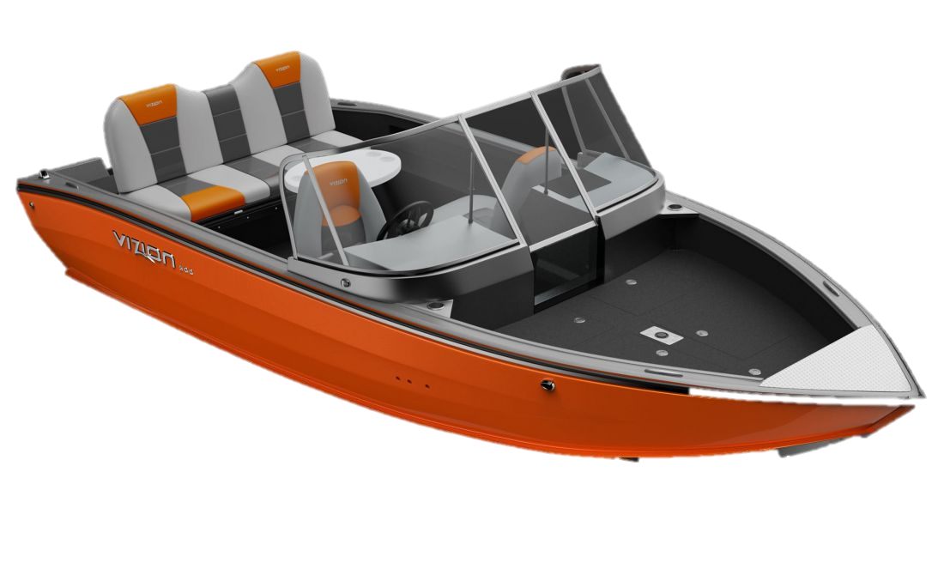
truck
boat
motorbike

Slide 17
Point and say!

Slide 19
Let’s stick!

Slide 20
truck

Slide 21
Lesson 2
Unit 4
I go to school by bus

Slide 22
Listen ,point and repeat

Slide 24
Listen and sing

Slide 26
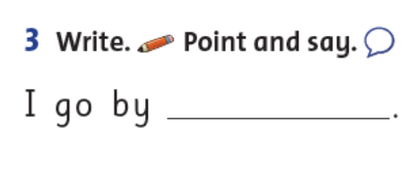
Write
bike

Slide 27
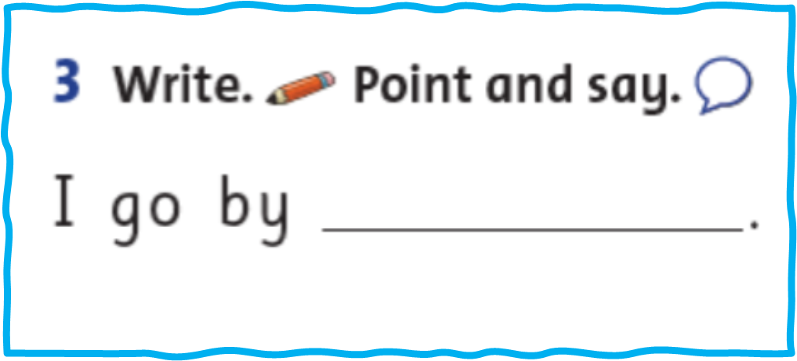
Point and say!

Slide 28
Workbook time!!! page 30-31

